Slide 1
Introduction to 2D Game Development
Course : 2D Game Programming
Effective Period : September 2018

Slide 2
These slides have been adapted from: Pereira, V. (2014). Learning Unity 2D Game Development by Example, Packt Publishing, Inc. San Francisco. ISBN: 9781783559046 Chapter 1
Acknowledgement

Slide 3
Learning Objectives
LO 1 : Create 2D game for PC platform
LO 3 : Design 2D game for PC platform

Slide 5

Real Time Rendering
Shoot The Penguin

Slide 6

D0T Game engine

Slide 7

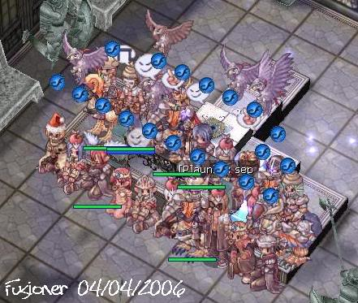

Me and Games…

Slide 8
Learning Objectives
LO 1 : Create 2D game for PC platform
LO 2 : Apply best practices of 2D game development
LO 3 : Design 2D game for PC platform

Slide 9

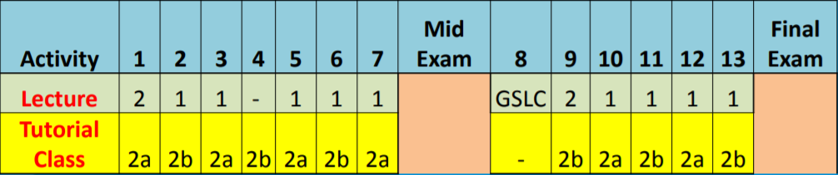
Timeline
BASIC GAME
DESIGN
PROTOTYPE
ALPHA
Released
RELEASED
Assignment : 40%
Final Exam : 60%

Slide 10
Detail Assessment
 | MIN | MID | MAX
Weekly Dev. Log [10 %] | Not updated [0-1 %] | Regularly Updated [2-9%] | Always updated [10%]
Prototype [20 %] | Reflecting the basic game [0-6 %] | Reflecting the game twist [7-12 %] | Reflecting the game flow [13-20 %]
Game Page [10 %] | Game page is accessible [0-2%] | It have a proper promotional art (e.g. animated gif & banner) and theme [`3-8 %] | Complete information with trailer and promotional art [9-10%]
Uniqueness [15 %] | Theme only [0-5 %] | Gameplay [6-10%] | Gameplay & theme [11-15%]
Execution [30 %] | Game has many bug, design flaws & unimplemented design. [0-10 %] | Game has moderately bug and design flaws. [11 - 20%] | Game is complete with moderately bug and design flaws. [21-30 %]
Completion [15 %] | Game can not be ended or have an incomplete loop [0-5 %] | Game can not be ended or have an incomplete loop but have a finished game element. [6-10%] | Game can be ended or have a complete loop with a finished game element [11-15%]
Notes:
Apakah kita akan masukkan nilai saat mid exam

Slide 11
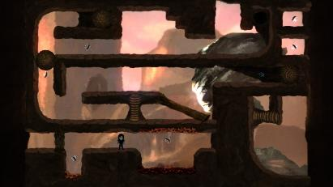
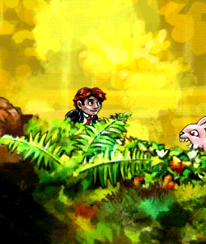


Game Theme
PLATFORMER WITH A TWIST

Slide 12
Game Theme
PLATFORMER WITH A TWIST
Member/ team : 1-5
Platform : PC
All team is formed on Week 3
Name of the team
Itch.io private link
Devlog regarding the basic of your game idea and team member with their role (min. 250 words)

Slide 13
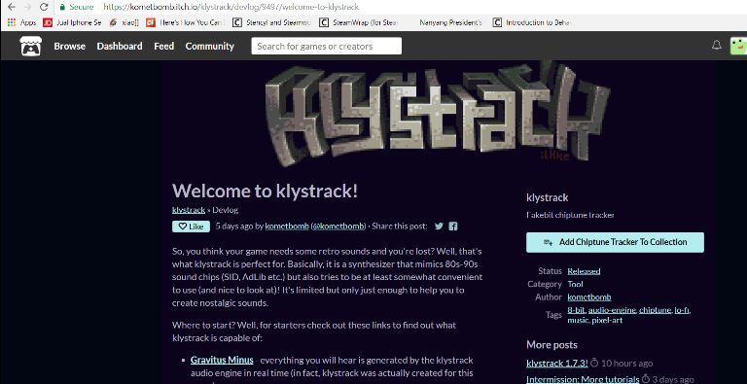
Weekly Devlog

Slide 14
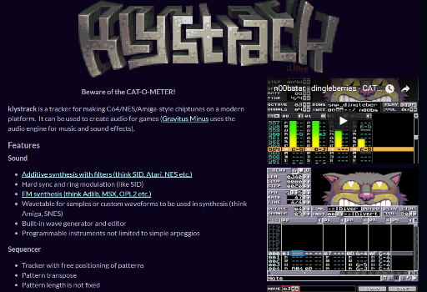
Game Page

Slide 15
Current 2D game?

Slide 16
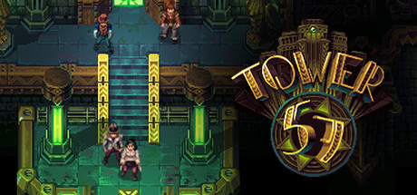
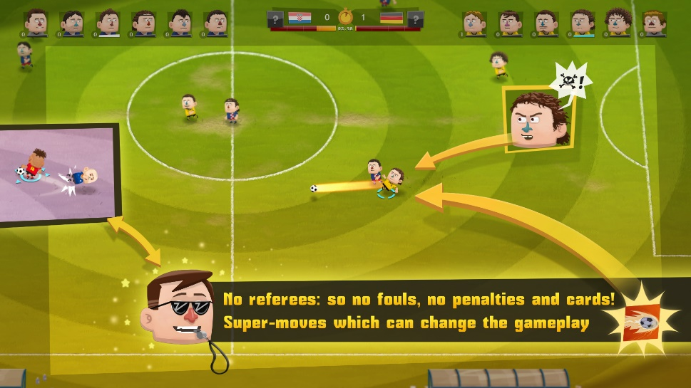

Slide 17
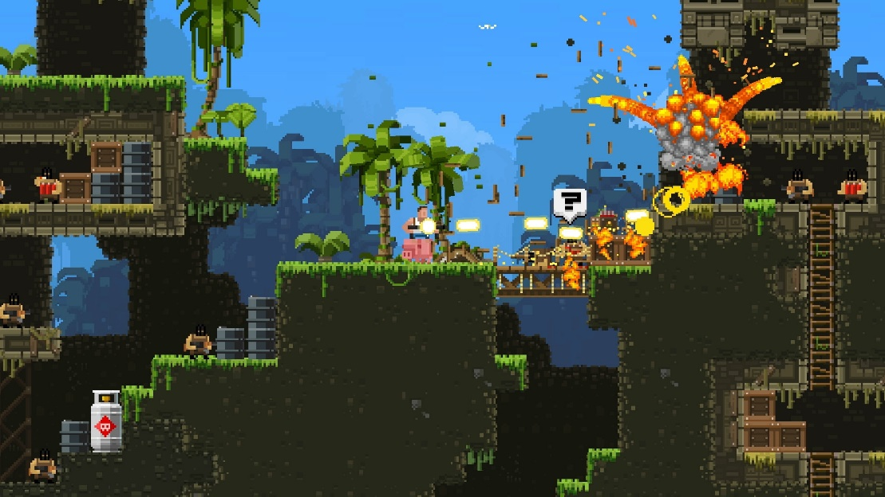
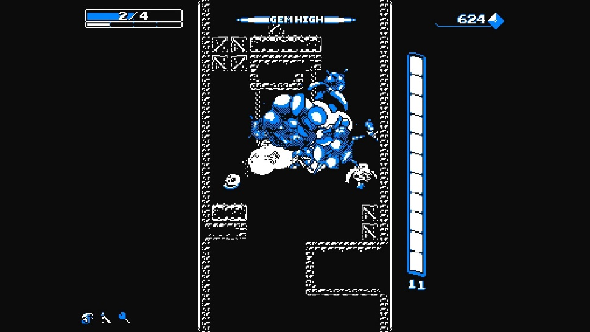

Slide 18
2D Game History

Slide 19
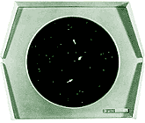
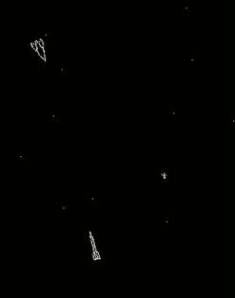
Spacewar! - 1962
Stephen "Slug" Russell, MIT
DEC PDP-1 assembler in 1962
Demonstrate the Type 30 Precision CRT Display
“It should demonstrate as many of the computer's resources as possible, and tax those resources to the limit;
Within a consistent framework, it should be interesting, which means every run should be different;
It should involve the onlooker in a pleasurable and active way -- in short, it should be a game.”

Slide 20
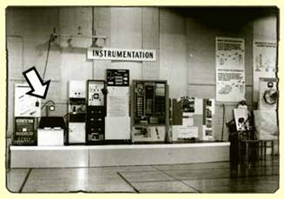
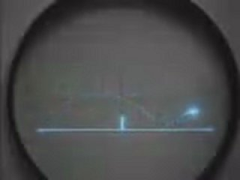

Tennis for Two - 1958
William Higinbotham
Demonstrate system
Analog computer
Real-time game

Slide 21
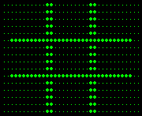
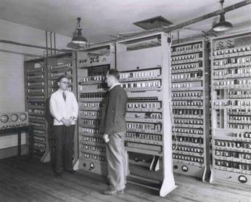
A.S. Douglas - 1952
Part of Ph.D. thesis in Human-Computer Interaction
Tic-Tac-Toe
Play by dialing numbers
Computer opponent
Emulator
http://www.dcs.warwick.ac.uk/~edsac/

Slide 22
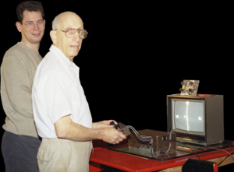
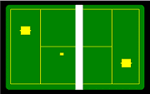
Ralph Baer - 1951
Asked to Build the best television set in the world.
Built in several prototypes between 1966-1968
Hand controller and light gun
Use of sensor
Magnavox signed an agreement in 1971 and the first video game system got released in May 1972: Odyssey

Slide 23
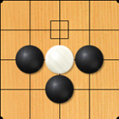

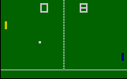
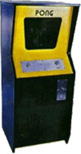
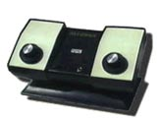
Nolan Bushell - 1972
Atari
syzygy
Pong
Arcade version, 1972
TV-console, 1975
Difficulties getting bank loans due to association with pinball and mafia

Slide 24
2D Game Development Discussion
Why 2D games? Why not 3D?
Comparison of the quality of current 2D game and in the past?
What is the latest AAA games that uses 2D art?

Slide 25
Unity History
Started as exclusive 3D game engine
Answers of the ever increasingly challenging barrier of entry to game development.
Uses C#, BooScript and JavaScript

Slide 26
Starting Unity
Go to http://unity3d.com/unity/download.
If we are installing Unity for the very first time, then we will need to sign up for a Unity account first through https://store.unity3d.com/account/ users/new.
Click on Looking for an older version? under the Download Unity button.
We need to ensure that we select and download latest version of Unity for our platform, whether it is a PC or Mac.*
Follow the onscreen prompts during the installation.
Make sure not to uncheck the default components as we will need them when creating our games.
Once we have successfully installed Unity, we need to run the application. Run the Unity.exe application.
You may use the latest version at your own risks !!!

Slide 27
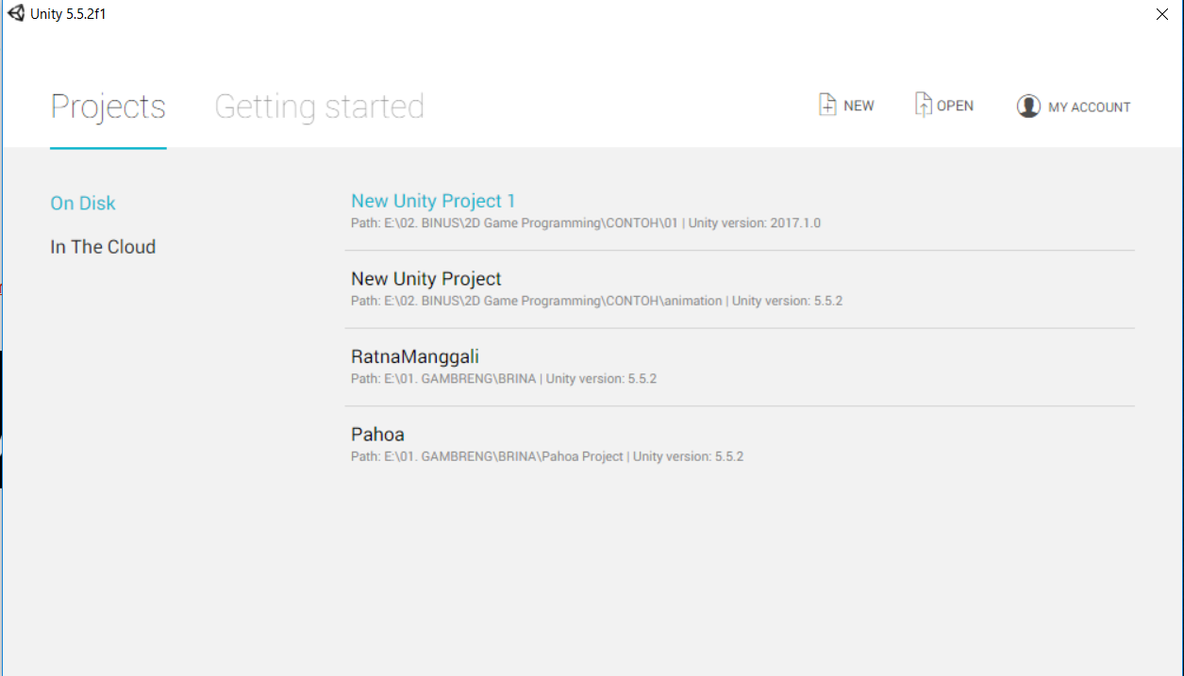
Create 2D Unity Project
When you create a new project, make sure that the setup default is set to 2D

Slide 28
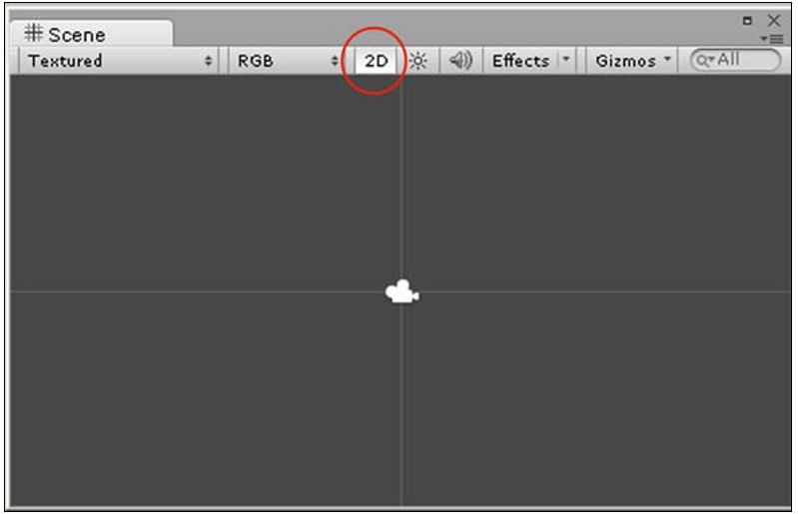
2D Unity Project
Once we have created our new 2D project, we can also toggle the view from 3D to 2D and vice versa. Whenever we wish to do so, we just click on 2D in the Scene View control bar.

Slide 29
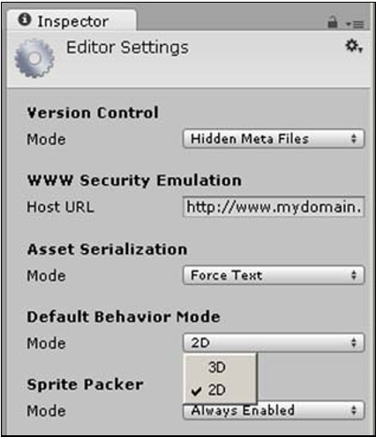
2D Unity Project
You forgot to change the default behaviour mode to 2D? You can select the 2D mode by selecting 2Din Inspector Tab

Slide 30
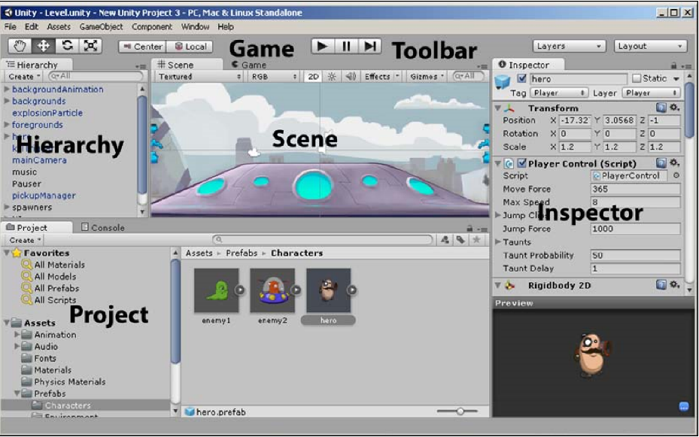
Unity Editor Interface
The main editor window is made up of Views. Views are all the tabbed windows that you see, namely: Toolbar, Scene, Game, Project Browser, Hierarchy and Inspector

Slide 31

Toolbar
The Transform tools are used with Scene View to drag the camera, move the position of objects, and rotate and scale objects in the scene respectively.
When we add an object to our scene and select it, we can see arrows protruding along the x and y axes from our object. These arrows are called Transform Gizmos, and we use them to move, rotate, and size our objects.

Slide 32
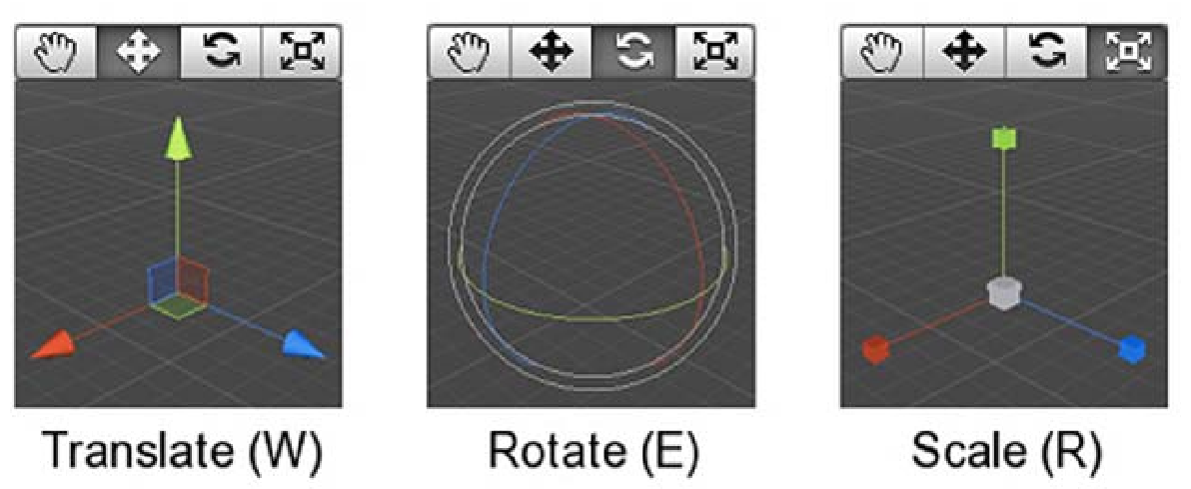
Toolbar
Translate (the shortcut key is W) is used to move the selected object in our scene, Rotate (the shortcut key is E) is used to rotate our selected object and Scale (the shortcut key is R is used to increase or decrease the size of our object.

Slide 33


Toolbar
The Transform Gizmo toggles are used to toggle the position of the Transform Gizmos. Center will position them at the center of the object, whereas Local will position them relative to the object's rotation.
Above is the control that is used with Game View to play, pause, and step through the game in the editor

Slide 34


Toolbar
The Layers drop-down box is used with Scene View to choose which objects we want to see in the editor's Scene View according to the layer.
The Layout drop-down menu enables us to set up the positioning of the interface to our own liking.

Slide 35
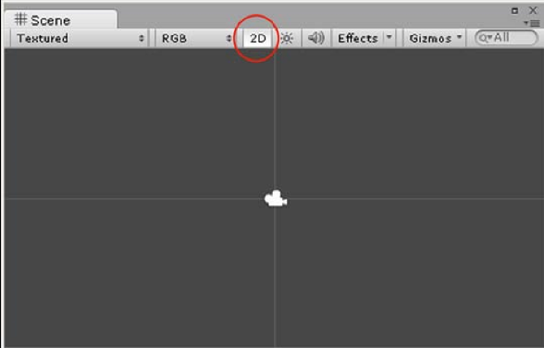
Scene View
Scene View is the area where we will interact with our GameObjects such as cameras, backgrounds, the player, enemies, and so on. It is within this view that we can position and transform our GameObjects.

Slide 36
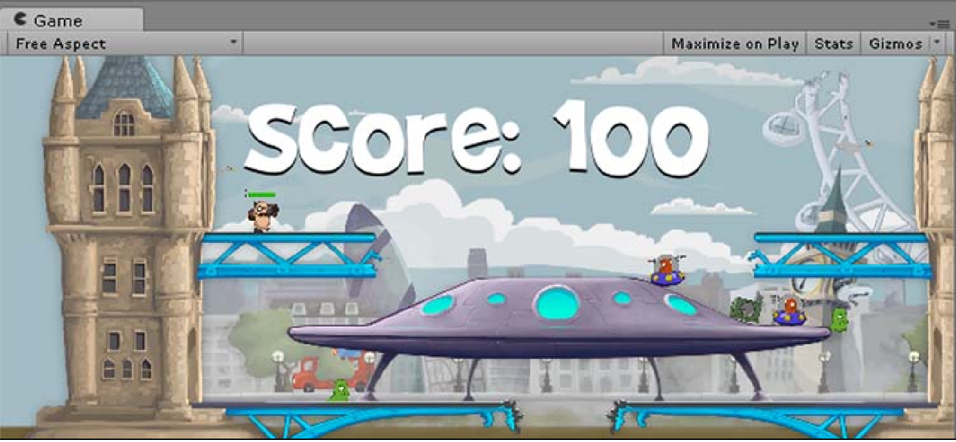
Game View
Game View displays the final published game rendered from the camera view. This is where we test out our game.

Slide 37
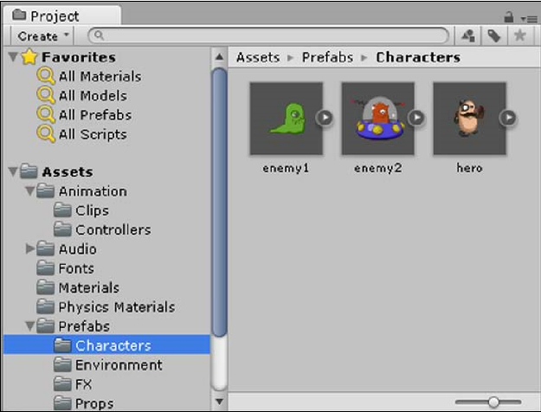
Project Browser
Assets are image files, audio files, programming scripts, and so on that make up the reusable mix-and-match pieces of our game.

Slide 38
Creating Assets
When making a game, some assets will be created outside of Unity (such as in an image-editing or sound-recording program). Those assets will be imported into Unity to be used, while other assets can be created inside of Unity, such as cameras, game objects, scripts, and animations.

Slide 39
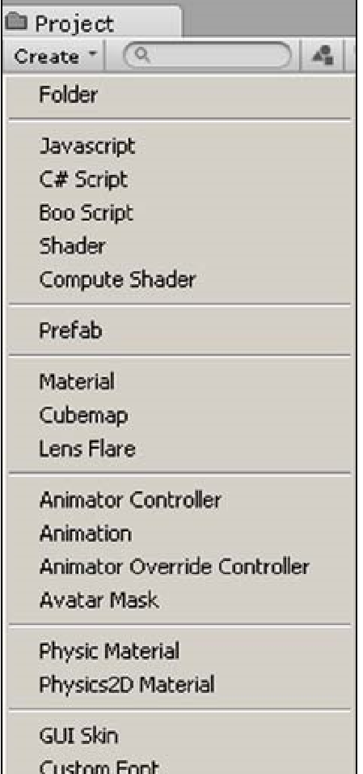
Creating Assets
When we click on Create, at the top of the left panel, we are given a list of assets that we can create,

Slide 40
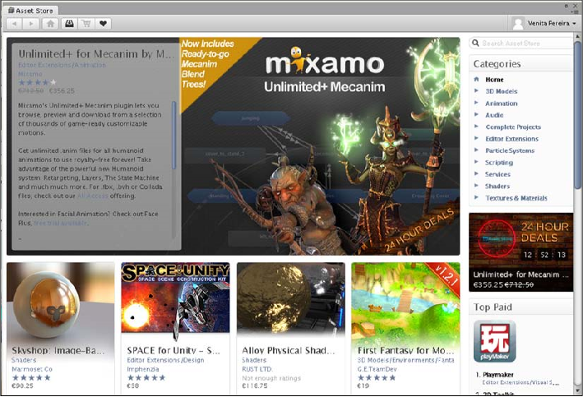
The Unity Assets Store
Asset Store is an online marketplace created by Unity for independent game developers to buy and sell reusable assets to make games.

Slide 41
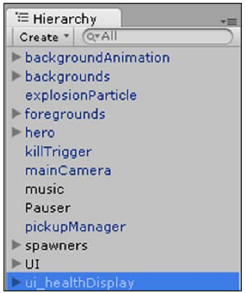
Hierarchy
The Hierarchy tab lists all the GameObjects in the current scene. Scenes are made up of game objects, and game objects make use of assets. We can easily access any GameObject in the scene from the Hierarchy tab for quick editing.

Slide 42
The Inspector
Game objects are the living things in our games, and the different components are what bring a game object to life in different ways. For example, the Audio Source component allows a game object to emit a sound, while a Script component allows a game object to behave intelligently or respond to user input.
When we click on a GameObject within our scene, the Inspector provides detailed information about that object. It displays all the components that have been added to the selected GameObject, such as animations, colliders, scripts, and so on, as well as all the attributes within the components. This allows us to directly modify its fields and their respective values from the Inspector.

Slide 43
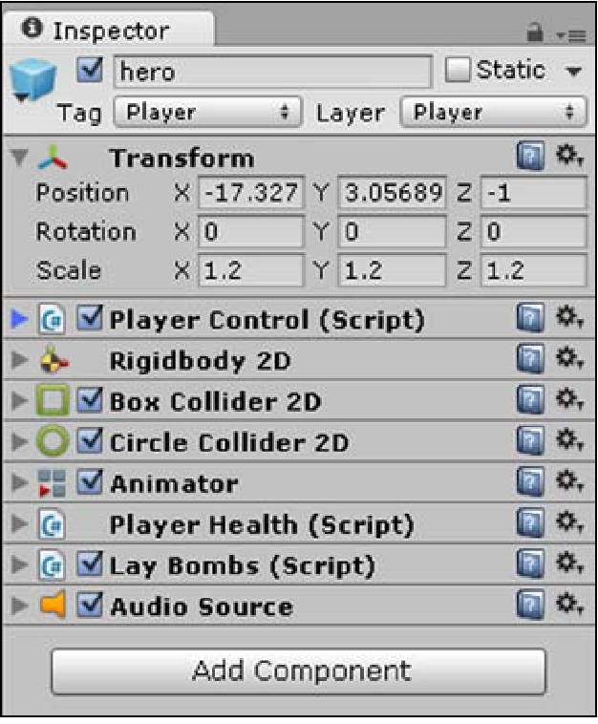
The Inspector
Whenever we do not want a component active at any time, we can simply deselect the component by deselecting the box. We do this to temporarily turn it off without losing its settings, because had we deleted it, then we would have lost any changes made to the default settings.

Slide 44
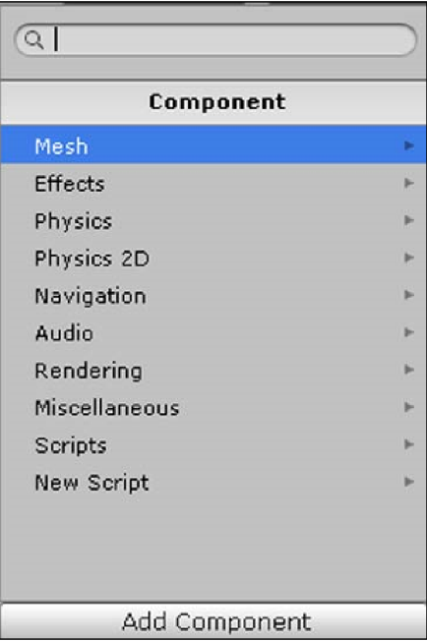
Add Components
To add a component to the selected GameObject, we click on the Add Component button. When we click on Add Component, we are given a list of components that we can create.

Slide 45
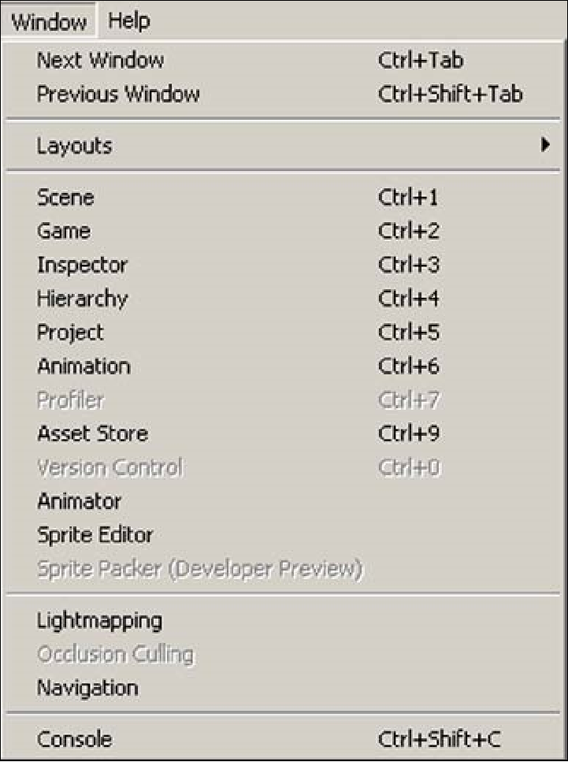
Extra Views
Other than the six main Views of the editor interface that are shown by default, there are extra Views that are also very useful.

Slide 46
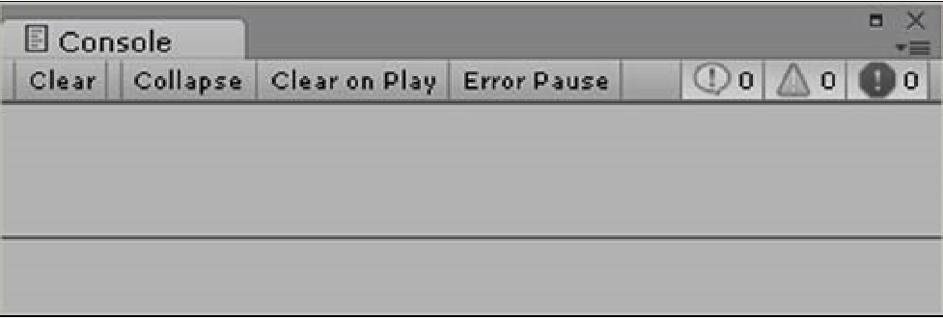
The Console
The Console View is useful when you write code to output messages and to check for any problems with the code. Any warnings and errors in the code will be displayed here. These messages only appear to us developers to test and debug our game and will not be shown in the final game to the players.

Slide 47
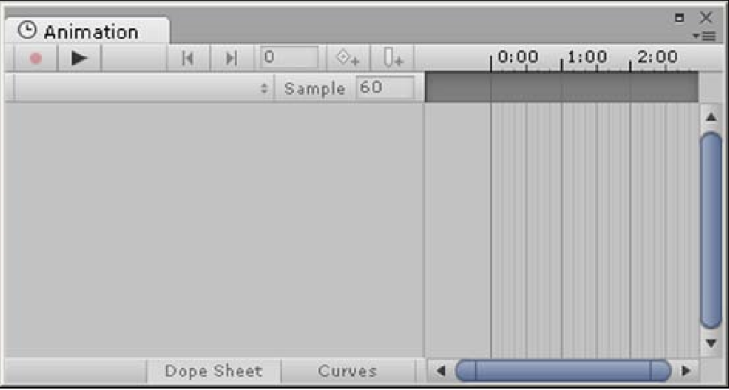
Animation
The Animation View is used to animate the GameObjects in our scene using an animation timeline with frames

Slide 48
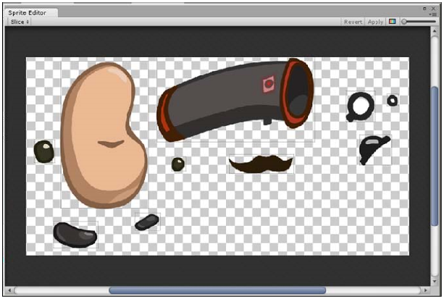
Sprite Editor
Sprite Editor enables us to separate merged images (known as a sprite sheet or The sprite atlas) from a single image (or sprite as it is often called in the world of 2D). It is useful, for example, for animations and when we want different parts of our character to move independently,

Slide 49
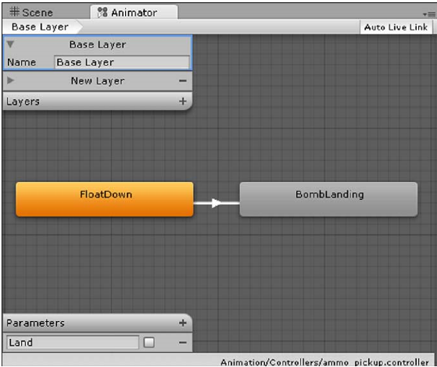
Animator
Animator controls the order of an animation. It provides an easy way to set up animations by visually representing the flow of the animation, such as the completion of a jump animation leading to a standing animation. It enables us to create animation states. We can then order the flow of animations and decide when one animation state transitions or blends into the next state.

Slide 50
Discussion
What are the benefit of using unity?
The current state of 2D games?

Slide 51
Q & A Session

Slide 52
References
Pereira, V. (2014). Learning Unity 2D Game Development by Example, Packt Publishing, Inc. San Francisco. ISBN: 9781783559046

